Slide 1

ASSIGNMENT ON DIGITAL MARKETING.
OBJECTIVE: TO ANALYZE COMPETITORS IN THE DIGITAL SPACE.

Slide 2
BRANDS:-
BLINKIT.
SWIGGY INSTAMART.
ZEPTO.

Slide 3
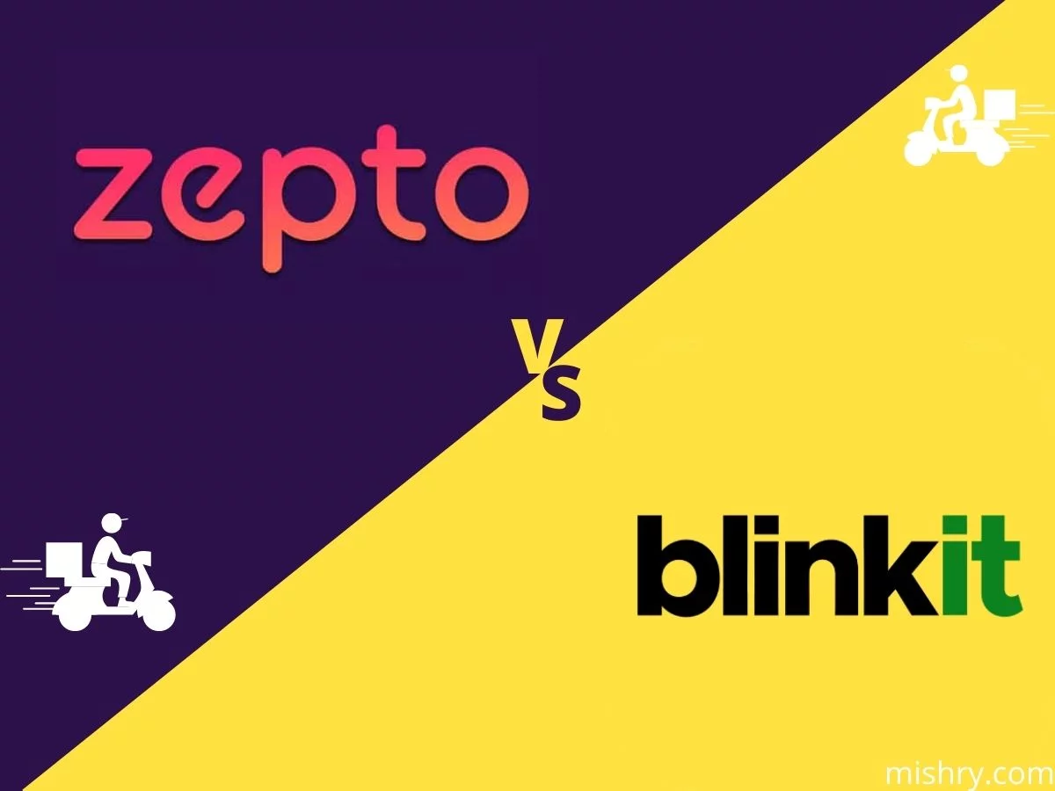
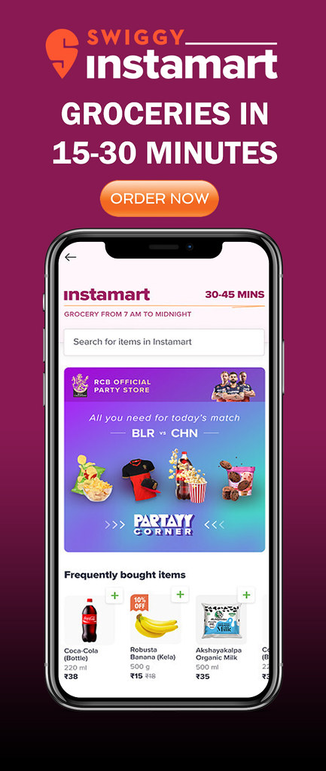
DIGITAL MARKETING STARTEGIES

Slide 4
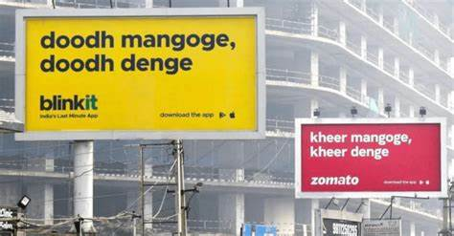
BLINKIT:
BLINKIT WAS FOUNDED IN DECEMBER 2013 BY ALBINDER DHINDSA AND SAURABH KUMAR AS GROFERS.
BLINKIT WAS EARLIER KNOWN AS “GROFERS”.
THEY OPT FOR MEME MARKETING THROUGH BILLBOARDS, WHICH WENT VIRAL WITHIN 24 HOURS
MARKETING THROUGH ADVERTISEMENTS ON VARIOUS SOCIAL MEDIA PLATFORMS.

Slide 5
SWIGGY INSTAMART:
IN AUGUST 2020, SWIGGY LAUNCHED ITS INSTANT GROCERY DELIVERY SERVICE CALLED INSTAMART.
THEY PUBLISHED BLOGS THAT SHED LIGIHT ON CURRENT EVENTS TO PROMOTE THE COMPANY’S GOALS AND SERVICES.
MARKETING THROUGH ONLINE ADVERTISING, SOCIAL MEDIA MARKETING LIKE FACEBOOK,INSTAGRAM,YOUTUBE ADDS,AND MANY MORE.
EMAIL MARKETING-SWIGGY HAS A HIGHLY SUCCESFUL EMAIL MARKETING.THEY USE EYECATCHINGVISUALS,HUMOR,PERSONALIZE MESSAGES,COUPONS,DISCOUNT CODES.

Slide 6
ZEPTO:
FOUNDED IN 2020 AND LAUNCHED IN JULY 2021,ZEPTO BECAME WELL-KNOWN AS ONE OF THE FASTEST GROWING STARTUP IN INDIAN HISTORY.
AADIT PALICHA STARTED ZEPTO WITH KAIVALYA VOHRA IN 2020 WHEN THEY WERE 17 YEARS OLD.
SUPER FAST DELIVERY IS ONE OF THE ZEPTO’S INCREDIBLE MARKETING STARTEGY. “10 MINS DELIVERY STARTEGY.”
FOR THE MOVIE “AVATAR:THE WAY OF WATER; ZEPTO CREATED A MEME TO GRAB CUSTOMER’S ATTENTION BY FOLLOWING THE ONGOING TREND. THERE ARE PLENTY OF MEMES IF YOU VISIT ZEPTO’S SOCIAL MEDIA PAGE.
THEY ALSO COLLABORATE WITH SOCIAL MEDIA INFLUENCERS TO MAKE VIDEOS FOR THEM.

Slide 7
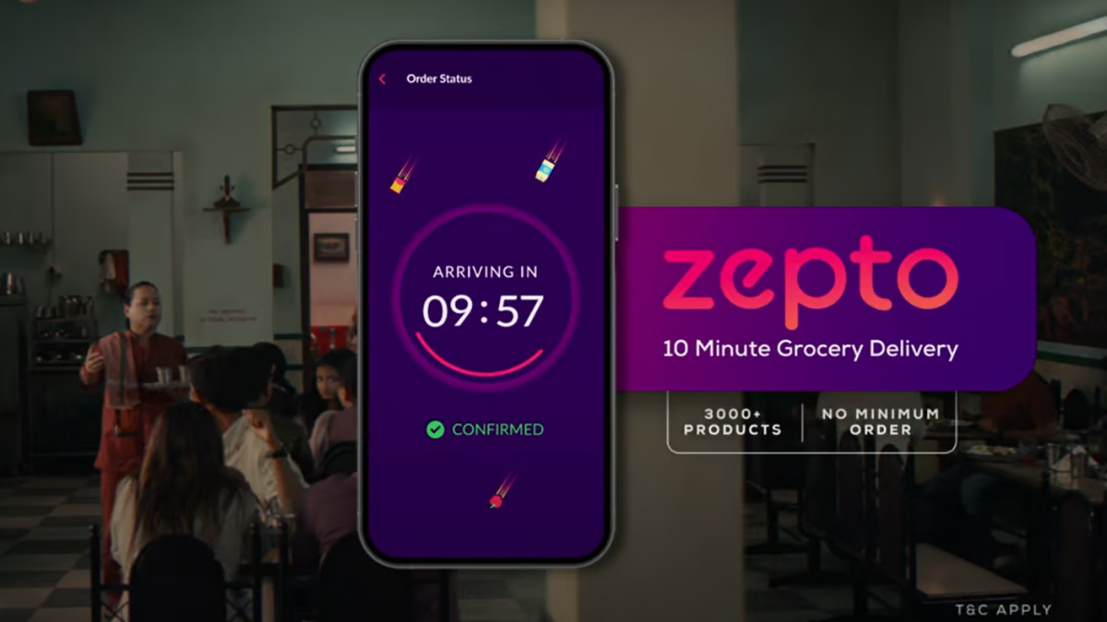
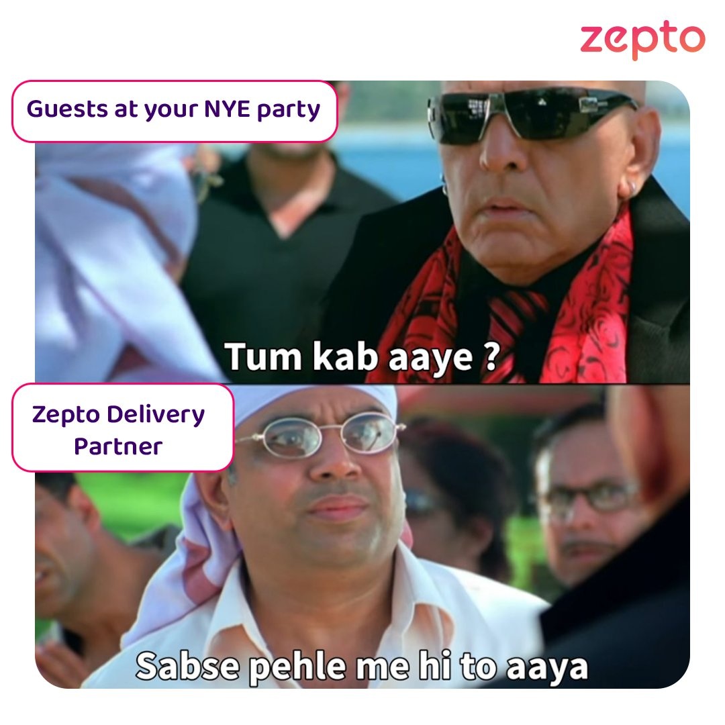
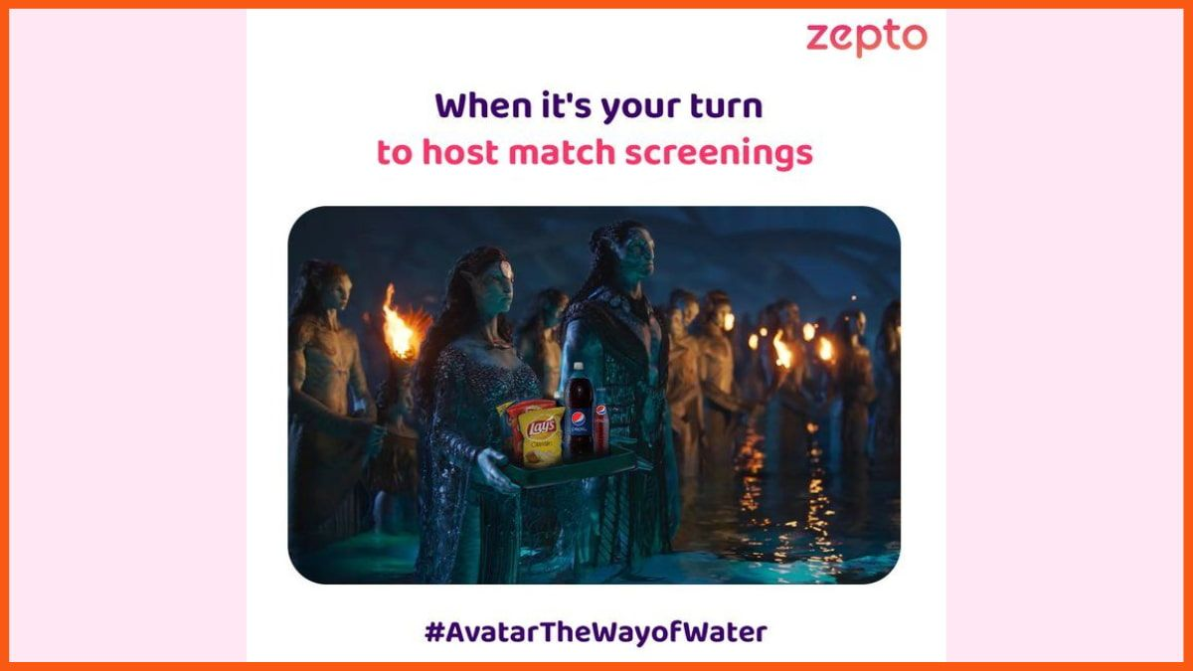
MEME MARKETING THROUGH ZEPTO:

Slide 8
SOCIALMEDIA PRESENCE-
BRAND NAME | INSTAGRAM | FACEBOOK | TWITTER | LINKEDIN
BLINKIT | 226K FOLLOWERS. | 318K FOLLOWERS. | 71.4K FOLLOWERS. | 737K FOLLOWERS.
SWIGGY INSTAMART | 119K FOLLOWERS. | 17K FOLLOWERS. | 33.5K FOLLOWERS. | 2M FOLLOWERS.
ZEPTO | 312K FOLLOWERS. | 121K FOLLOWERS. | 33.2K FOLLOWERS. | 417K FOLLOWERS.

Slide 9

WEBSITES-
BLINKIT: https://www.blinkit.com
SWIGGY INSTAMART: https://www.swiggy.com
ZEPTO: https://www.zeptonow.com

Slide 10

THANK YOU

